Slide 1
Automated Weather Window
Cyril Bernardo
David Fijas
Pawel Sawicki

Slide 2
Overview
Problem Statement
Problem Solution
Goals
Cost, Design, Theory
Advantages and Disadvantages
Conclusion

Slide 3
Problem Statement
It is not uncommon for a parked car to have its windows open and unattended when it begins to precipitate, exposing the interior of the car to the weather. Even more frequently, a car with closed windows will be exposed to direct sunlight, rapidly increasing the interior temperature to uncomfortable levels.

Slide 4
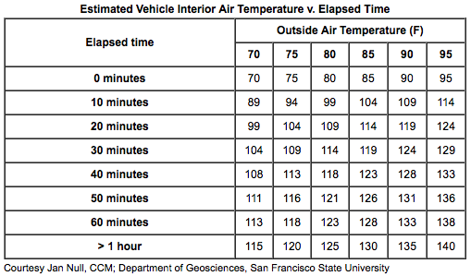
Problem: Temperature

Slide 5
Problem: Temperature
The average person will be comfortable at 72 °F
A car in direct sunlight with closed windows will rapidly surpass this temperature within 20 minutes
This is also a very dangerous issue for passengers that may have been left in the vehicle
On average, a child dies every 9 days
Hundreds of pets die per year due to vehicular heat stroke

Slide 6
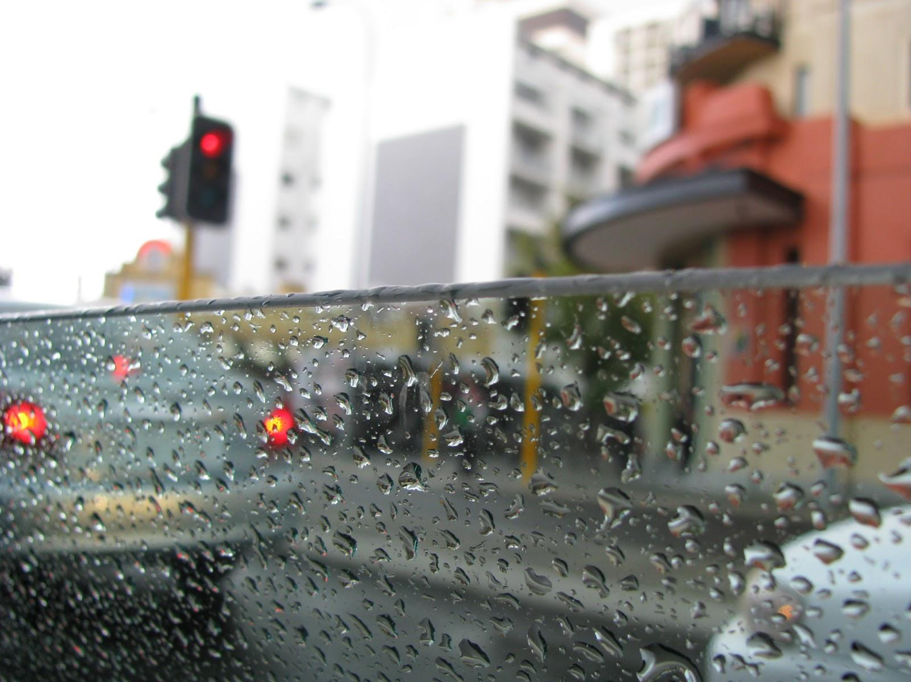
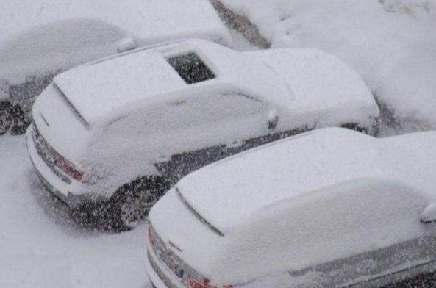
Problem: Precipitation
Many people leave their windows, sunroof or convertibles open while leaving their car parked
Car upholstery and electronics can be damaged through rain exposure

Slide 7
Problem Solution
The Automated Weather Window adjusts the window when it detects undesirable conditions
The windows/sunroof will open slightly when the temperature in the car is too high in order to ventilate the car
The windows/sunroof will close if left open when there is precipitation to protect the interior

Slide 8
Solution Features
Automated window system will intermittently check the internal temperature and weather conditions
Temperature:
When internal temperature exceeds 80℉, the side windows and sunroof will automatically open 0.5”
Precipitation:
When rain or snow is detected, the side windows and sunroof will automatically close

Slide 9
Goals
Create a proof of concept
IR sensor must react to water being placed on plexiglass and engage servo motor to close the window
DS1620 must engage servo motor to open window 0.5” when temperature is at or above 80℉
IR sensor must take precedence over servo

Slide 10
Bill of Materials

Slide 11
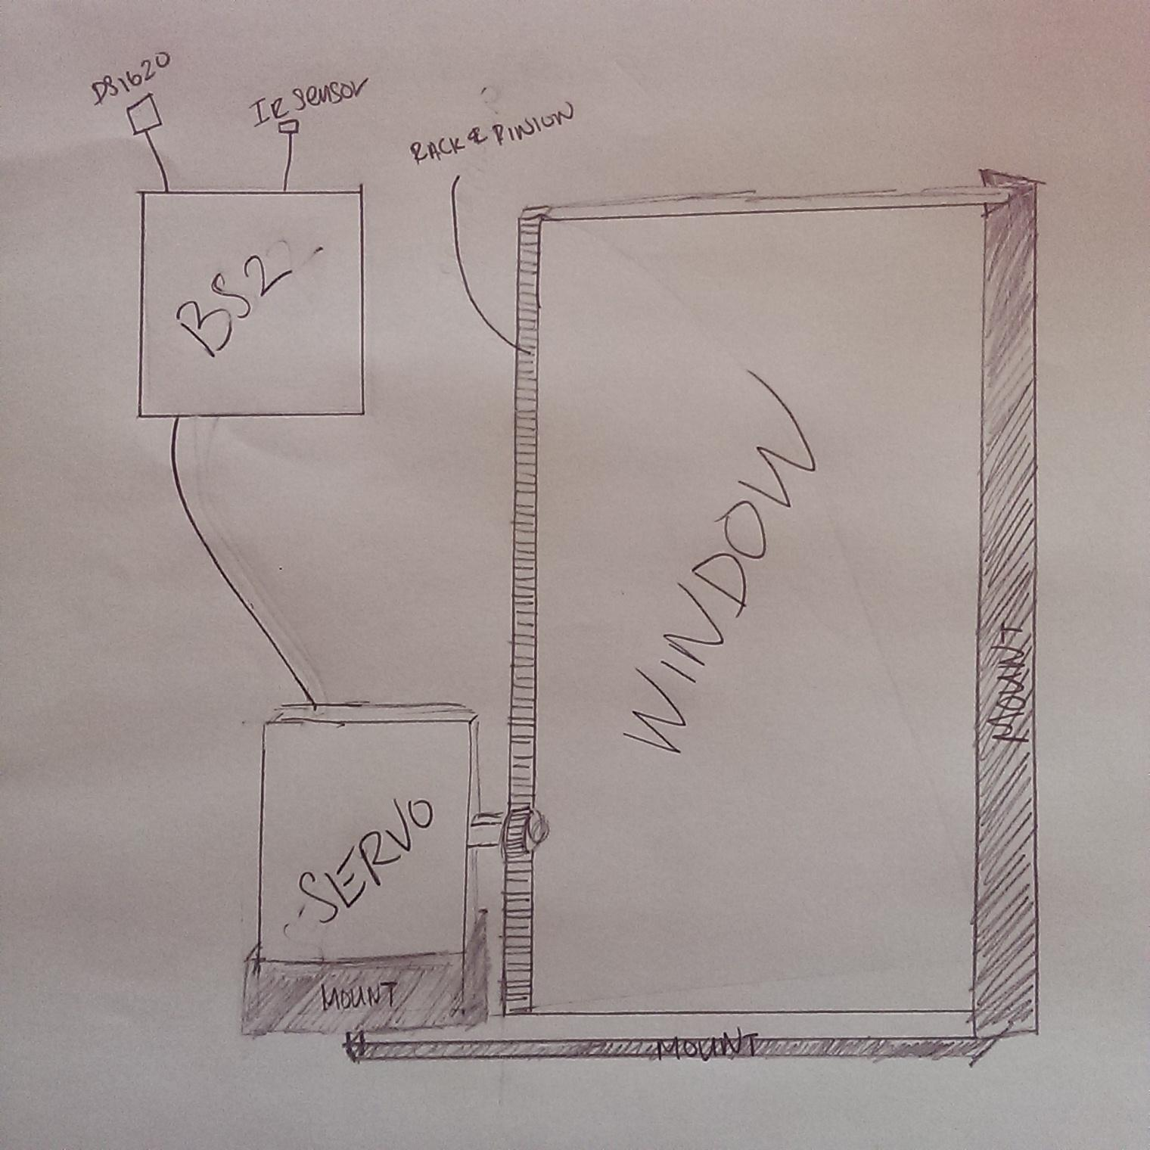
Preliminary Model Design

Slide 12
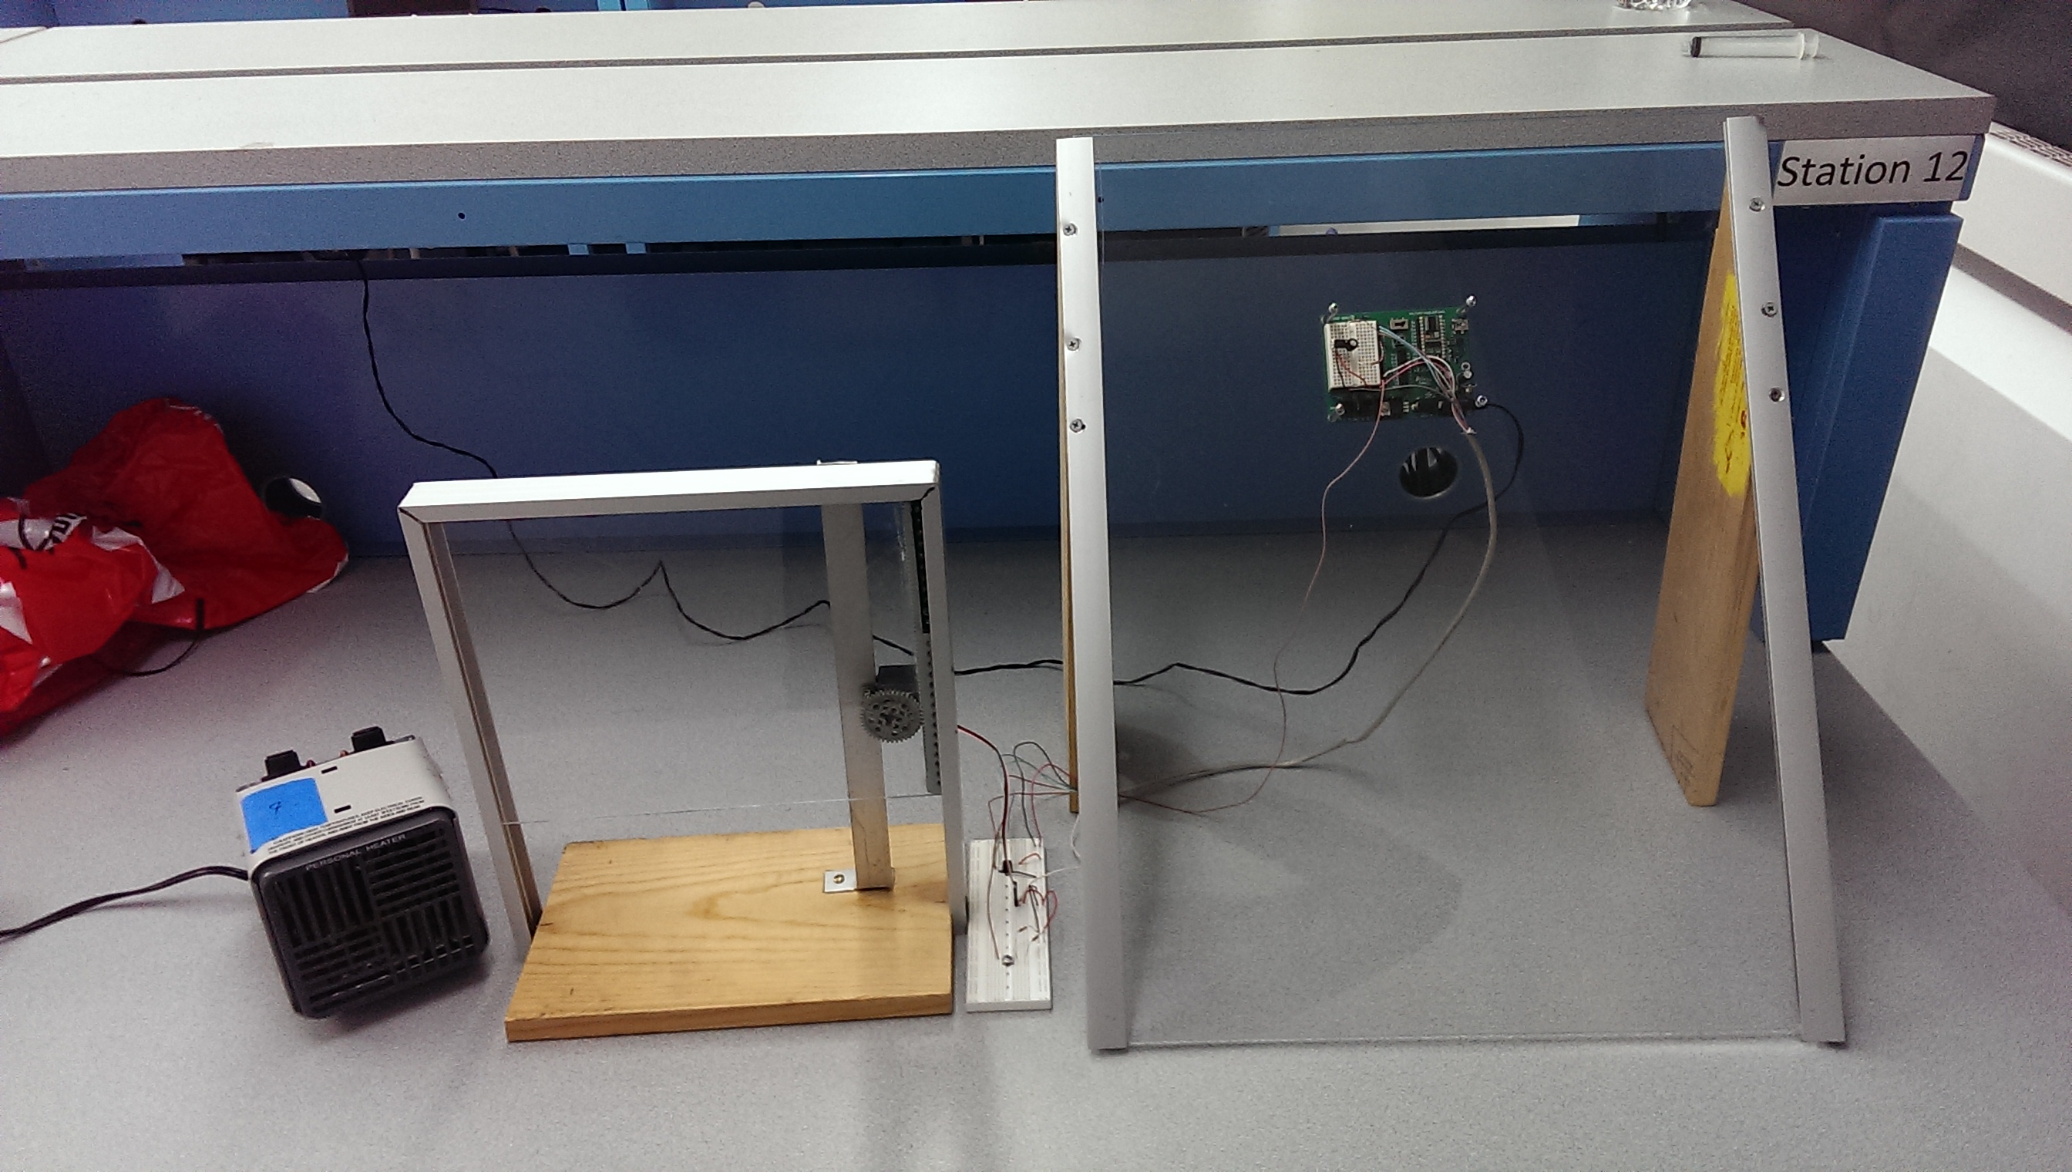
Prototype

Slide 13
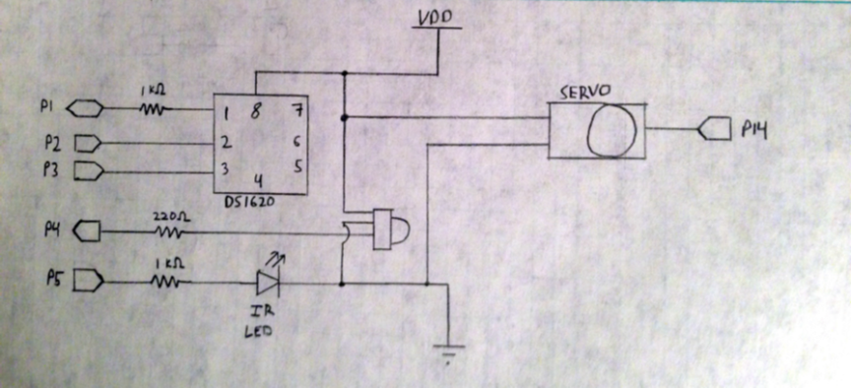
Preliminary Circuitry Design

Slide 14
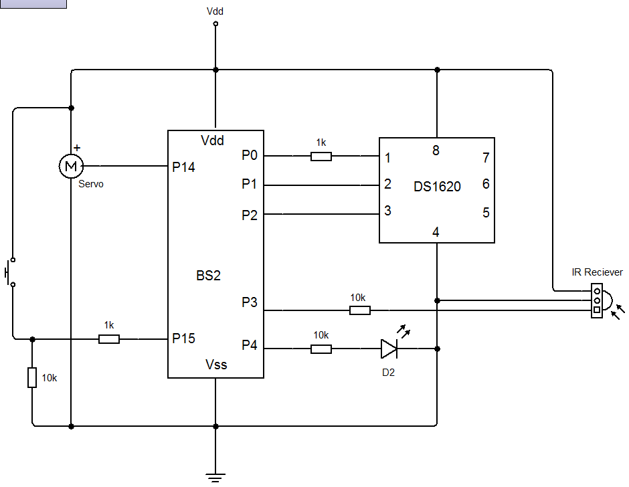
Final Circuit Design
Normally Open Switch to simulate ignition key presence
Infrared receiver and LED paired with Parallax BS2 Pins 4 and 3, respectively
DS1620 Paired with Pins 0, 1, and 2

Slide 15
Programming

Slide 16
Programming

Slide 17
Programming

Slide 18
Programming

Slide 19
Programming

Slide 20
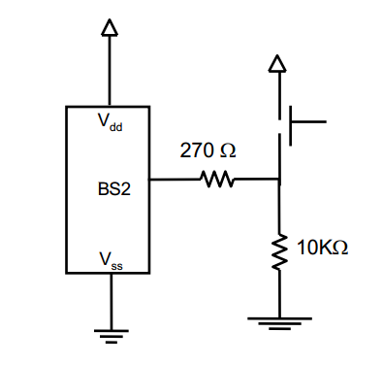
Theory – Switch/Pull Down Resistor
When switch is not pressed, BS2 input is “pulled” to ground
When switch is pressed, BS2 input is brought up to 1
Prevents floating input

Slide 21
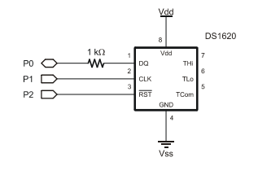
Theory – DS1620 (Digital Thermometer)
DS1620 accurately reads temperature surrounding chip
Can compare found temperature to a reference temperature
When found temperature exceeds the reference, BS2 chip will activate servo and open window

Slide 22
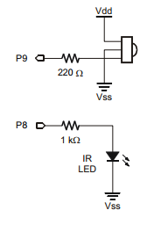
Theory – IR Circuit
IR LED rapidly flashes at 38500 Hz
If this light strikes the IR receiver, it returns a 0
Otherwise returns 1
If water strikes plexiglass, it causes the IR Light to reflect to the receiver
Under this condition, BS2 will activate servo to close window

Slide 24
Mass Production Costs
In cars equipped with a rain sensor/power windows/thermometer, there will be no cost to mass produce
Otherwise, will require an estimated increase of approximately $85 to put in the needed circuitry

Slide 25
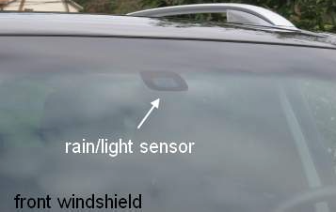
Implementation
This solution would be implemented into current vehicles that have rain sensors and power windows
No extra materials would be required, only the program to connect the sensor inputs to the window motor outputs

Slide 26
Implementation

Slide 27
Advantages
Added protection to the car
Can save a child/pet’s life on a hot day
No increased cost in cars already equipped with a rain sensor/power windows/thermometer

Slide 28
Disadvantages
Currently technology is only in higher end vehicles
Could increase possibility parents/pet owners leave child/pet behind

Slide 29
Conclusions
This system will work in any car that has a rain sensor and power windows
Cost effective to implement
Free in technologically updated vehicles
Cheap cost to older car models
Could save the lives of children and pets

Slide 30
Bibliography
https://www.avma.org/public/PetCare/Pages/pets-in-vehicles.aspx
http://www.hlntv.com/interactive/2014/07/08/children-hot-car-deaths-map-2014
http://www.kidsandcars.org/heatstroke.html
http://www.parallax.com/sites/default/files/downloads/27297-StampWorks-Manual-v2.1.pdf
http://www.ergonomics4schools.com/lzone/temperature.htm
Lindsay, Andy. Robotics with the Boe-Bot: Student Guide : Version 3.0. S.l.: Parallax, 2004. Print.
Lindsay, Andy. Experiment Kit: Student Guide : Version 2.1. S.l.: Parallax, 2006. Print.

